Slide 1
Markov Decision Processes & Value Iteration
Michael Evangelista (michael@powerof.to)
2019-05-23

Slide 2
What We'll Cover
Reinforcement Learning overview/review
Describing problems with an MDP
Using Value Iteration to learn best actions
Implement and run Value Iteration in code
Learn how these methods extend to more complex problems

Slide 3
Reinforcement Learning Review

Slide 4
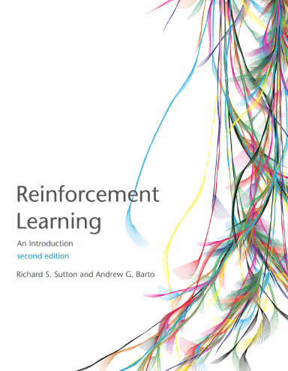
Reinforcement Learning
"Reinforcement learning is learning what to do— how to map situations to actions—so as to maximize a numerical reward signal. The learner is not told which actions to take, but instead must discover which actions yield the most reward by trying them. In the most interesting and challenging cases, actions may affect not only the immediate reward but also the next situation and, through that, all subsequent rewards. These two characteristics—trial-and-error search and delayed reward—are the two most important distinguishing features of reinforcement learning."
Sutton, Richard S., and Andrew G. Barto. “Reinforcement Learning: an Introduction.” Reinforcement Learning: an Introduction, The MIT Press., 2018, pp. 1–2.
Available as free PDF at http://incompleteideas.net/book/the-book-2nd.html
Notes:
I can't say better than Sutton and Barto
In short, RL is:
Learning how to best make sequences of decisions …
conditioned on situations, …
through trial-and-error, ...
using a possibly delayed feedback signal

Slide 5
Cool and Interesting Things
<<Atari Video>>
<<Helicopter Video>>
<<Robotics Video>>
Notes:
These are just visual things
There are a myriad of sequential decision-making problems that don’t demo so cool:
Control of systems like power plants
Inventory control decisions
<<think of a third>>
But... (CAVEAT)
Theory
(Simple) Math Ahead
Greek Letters

Slide 6
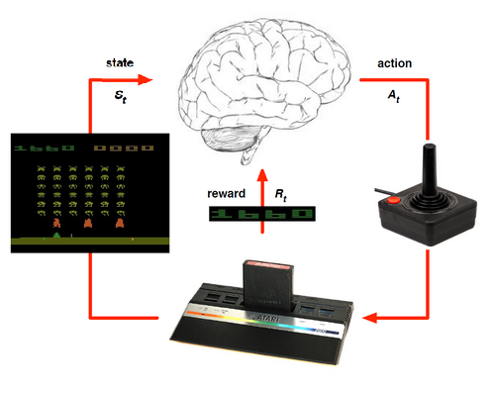
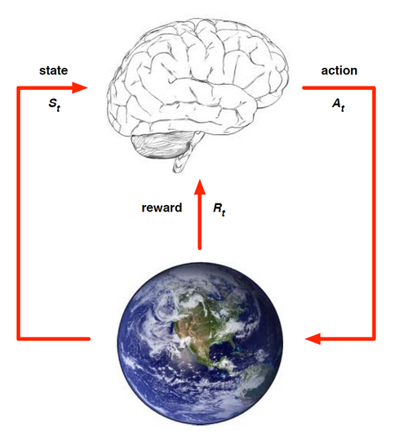
The Agent-Environment Loop
Agent receives state info S_{t} from Environment
Agent chooses action A_{t}
Environment transitions to S_{t+1}
Environment emits numerical reward R_{t+1}
Repeat (until task ends or forever)
Agent's goal: Maximize Return (cumulative reward from time t and continuing):
G_{t} = ∑_{k=0..∞} γ^{k} R_{t+k+1}
Image Credit: Silver, David. “Lecture 1: Introduction to Reinforcement Learning.” Advanced Topics 2015 (COMPM050/COMPGI13). http://www0.cs.ucl.ac.uk/staff/D.Silver/web/Teaching.html.
Note: Atari image slightly modified to represent state.
Notes:
What is an agent, what is environment and how do they interact?
RL Assumes this model...
What's a …. ?
Environment
Chess game
The physical world in which a robot is operating (the robot itself is part of the environment)
An Atari 2600 emulator running Space Invaders
State
The position of pieces on a chess board
The position of a robots arm joints and an image from its camera
The image from Space Invaders
Action
Move queen to queen's knight 4
Apply certain torques to robot motors
Move the Space Invaders ship left, right or fire
Reward
+1 if game is won, -1 for loss or 0 for draw (highly delayed)
A value inversely proportional to the distance from the robot's gripper to the target object
The score from the Atari game
Agent's job is to choose actions that maximize the total Future Return starting at time t.
Appendix:
Details (if they come up)
No Observation: For simplicity we will only deal with fully observed environments
Discrete time: Tasks can be continuing or episodic
David Silver Atari image modified to show state in lieu of observation for the purpose of simplification for this talk.

Slide 7
Markov Decision Process

Slide 8
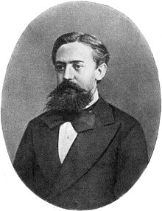
Markov Decision Process
Used to define sequential decision making problems
Defines possible states of the environment
Defines actions an agent may take
Defines the dynamics – how an action leads from one state to another and how the agent is rewarded
States have the "Markov Property"
Notes:
Andrey Markov

Slide 9
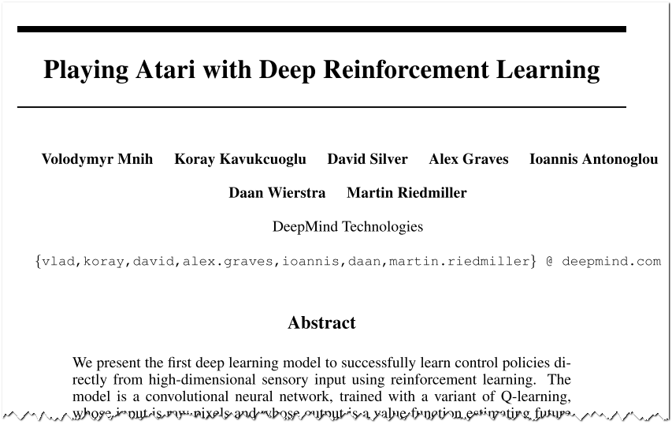
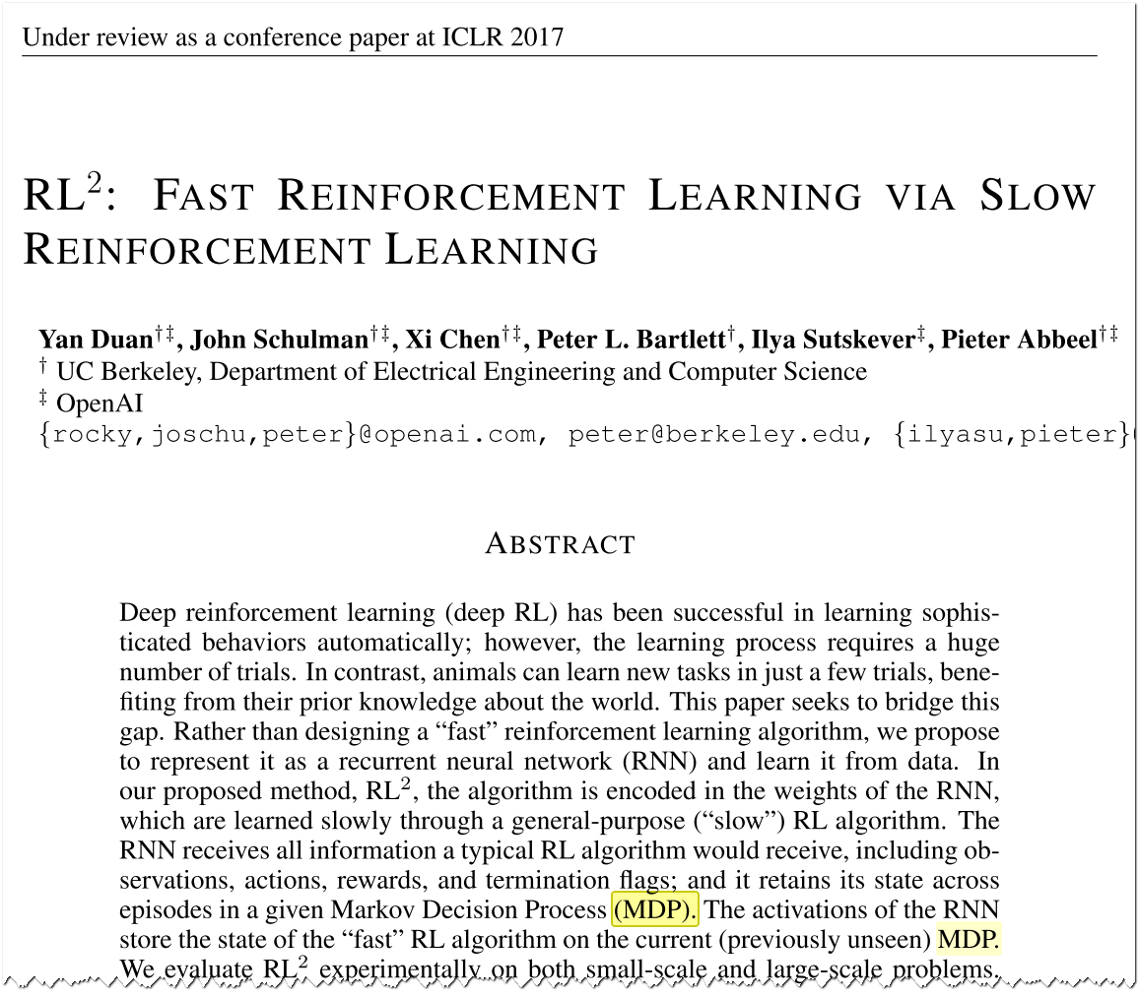
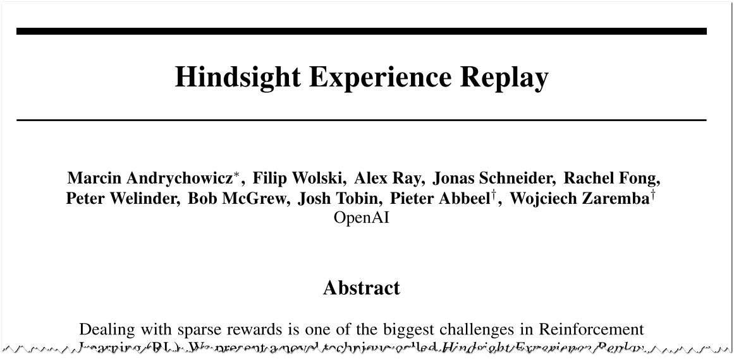
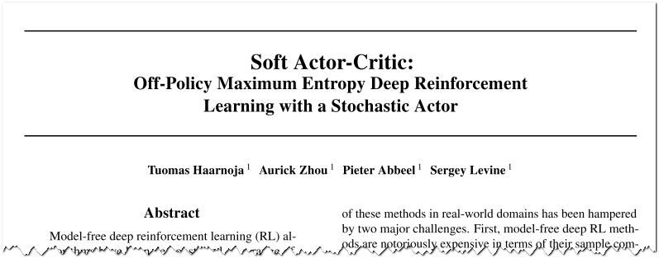
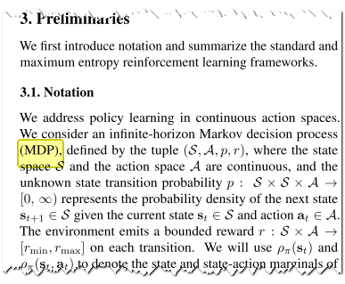
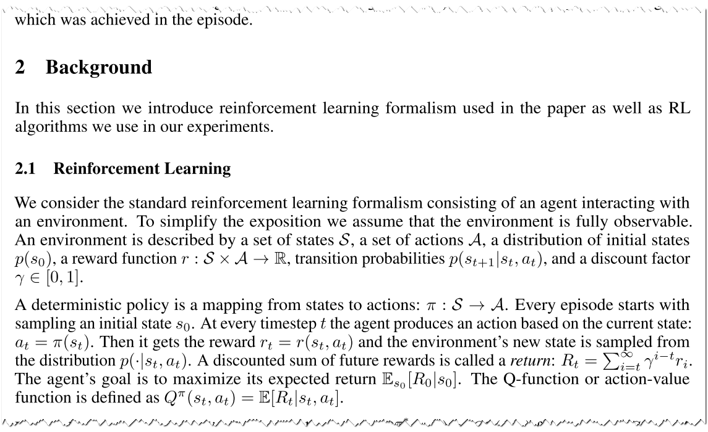
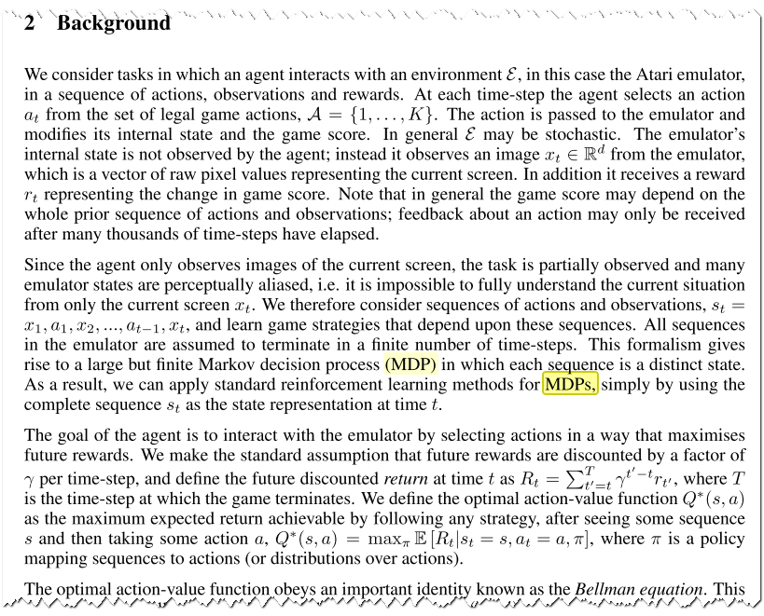
Why Bother? Let's get to the Tensorflow code!
Notes:
This is boring! Where's the Tensorflow code?
Sadly, we won't see TF code today.
Universal problem description
Provides a universal way to precisely characterize decision making problems...
And thus make precise statements about problems, and algorithms...
As well as apply algorithms to problems (think of it as an "API" to the problem)
Almost all RL research you read will lay out problems conceptually as MDP and use notation we'll see today...
Hence, if you want to study RL, you need this foundation
Can represent and solve real problems with MDPs
<<Examples>>

Slide 10
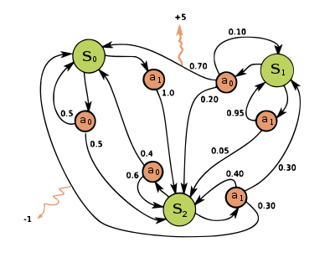
Example MDP Illustration
Image Credit: Wikipedia user waldoalveraz. "Markov Decision Process." Licensed under CC BY-SA 4.0.
Notes:
You might see them illustrated this way
But unless they are very simple, very difficult to draw like this.
Explain from state 0
The evolution of the system is driven by:
Our actions (red circles)
"Where the wind blows us" (David Silver) (outbound from actions)

Slide 11
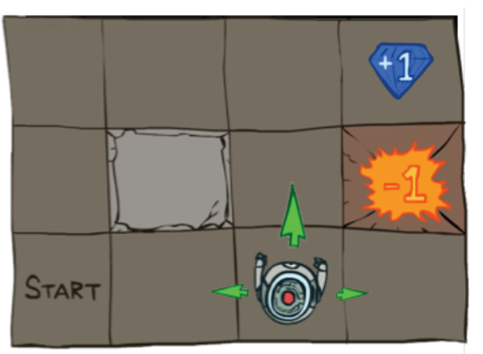
Grid World Rules
Get the diamond for a score of +1 (win the game)
Fall into fiery pit, get a score of –1 (and die)
Robot can move to any adjacent square (except on the edges and the blocked square)
Environment is stochastic (meaning, with some probability the robot may slip and go left/right instead of desired direction)
Any attempt to move to the rock or edge (whether intentionally or by slip) leaves you in current square
Game ends when the robot gets to a reward state (+1 or –1)
0
1
2
0
1
2
3
Image Credit: Abbeel, Pieter (2017). Deep Reinforcement Learning Lecture 1: Motivation + Overview + MDPs + Exact Solution Methods.
https://sites.google.com/view/deep-rl-bootcamp/lectures
Notes:
Canonical example
How do we describe this as an MDP?

Slide 12
Grid World as an MDP
Set of States - S
Set of Actions - A
Transition Probabity Function - p(s' | s, a)
Probability of ending up in state s', when taking action a from state s.
Reward Function - r(s, a, s')
Reward gained when action a causes transition from state s to state s'.
Initial State - s₀
Horizon - H
Why?
Discount Factor - γ
G_{t} = ∑_{k=0..H} γ^{k} R_{t+k+1}
Why?
0
1
2
0
1
2
3
Image Credit: Abbeel, 2017
Notes:
For each MDP attribute, what is it in this example?
States – the squares that the robot can be in.
We'll number them
The current state is square the robot is currently in
Actions - up/down/left/right
Technically the available actions can vary by state (but we'll ignore that)
Transition function
Jump to next slide for illustration
Horizon
Ensure our episodes end
Limit how long certain algos (like Value Iteration) can run
Needed by other algos (like Monte Carlo) which must process entire episodes
Discount Factor
Note we used H in the sum but could be INF.
Prefer nearer rewards (humans and animals)
Uncertainty about the future – don't count on a perfect model and uncertain future
Prevent diverging sums / mathematical convenience
Financial
Caveats
Conventions and notation varies a bit.
Don't be surprised
I try to follow Sutton and Barto notation
Using deterministic reward
S & B generally use stochastic rewards for generality
The math is ever so slightly different

Slide 13
Exercise 1: MDP Transition Probabilities
s' | p( s' | s=(2,2), a=up, slip=0.20)
(0,0) | 0
(0,1) | 0
(0,2) | 0
(0,3) | 0
(1,0) | 0
(1,1) | 0
(1,2) | 0.80
(1,3) | 0
(2,0) | 0
(2,1) | 0.20
(2,2) | 0
(2,3) | 0.20
 | 0 | 1 | 2 | 3
0 | (0,0) | (0,1) | (0,2) | (0,3) R=+1
1 | (0,1) | Rock | (1,2) | (1,3) R=-1
2 | (0,2) Start | (2,1) | (2,2) | (2,3)
Notes:
What happens if we move UP from (2,2)?
What about Up from (1,2)
Up 80%
Right 10% (into fire)
Left is impossible, so 10% chance you end up in (1,2)
Bonus question: If you're in (1,2) what action would you take?
Left: 10% chance end up in (0,2), 10% chance in (2,2)
Avoid fire pit
P = Imagine a 12x12x4 matrix of every action X s X s' combination.

Slide 14
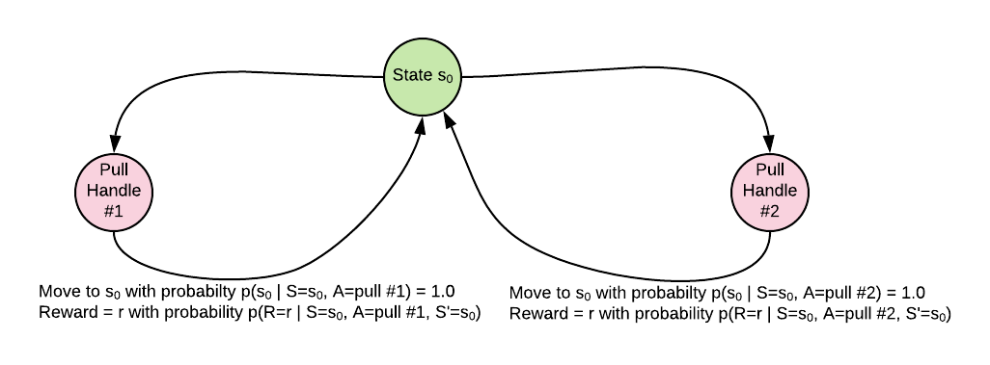
Remember Bandits (from sessions 1 & 2)?
A bandit is a one-state MDP...
... with stochastic (random) rewards
Notes:
Remember: we've been using deterministirc rewards in our examples (the math slightly simpler)

Slide 15
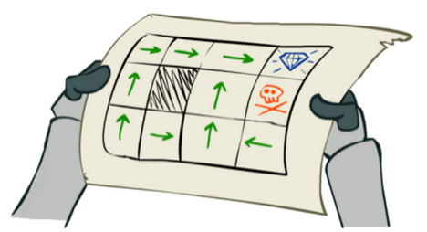
Solving the MDP
Find a policy, π*, that yields the best return:
π* = argmax_{π} E_{π}[G_{t} | π, s₀]
= argmax_{π} E_{π}[∑_{t=0..H} γ^{t} r(s_{t}, a_{t}, s_{t+1}) | π, s₀]
Wait – what the heck does this mean?
A policy, π, defines an agent's behavior
π* is the optimal policy. When followed, π* should, in expectation (i.e., on average), produce the highest possible return starting from any state
π
Image Credit: Abbeel, 2017
Notes:
What's a policy?
Defines agent's behavior given state.
Many policies can exist (go to school, study, get a job vs. stay at home and read Facebook)
Can be stochastic or deterministic. Today we'll deal only with deterministic
What's this expectation?
Find pi s.t. it maximizes...
The average return over all possible runs through the MDP...
Weighted by their probability
REMEMBER: while the agent is deterministic, the environment is not (remember slipping into the pit?)
How do we calculate this?
Value iteration algorithm!
But first some quick notation

Slide 16
The State- and Action-Value Function Definitions
State-Value Function under policy π:
Intuition: Expected return starting in state s and following policy π thereafter.
v_{π}(s) = E_{π}[G_{t} | S_{t}=s]
= E_{π}[∑_{k=0..∞} γ^{k} R_{t+k+1} | S_{t}=s] (By definition of G_{t})
Action-Value Function under policy π:
Intuition: Expected return starting in state s, taking action a as the first step, then following policy π thereafter.
q_{π}(s, a) = E_{π}[G_{t} | S_{t}=s, A_{t}=a]
= E_{π}[∑_{k=0..∞} γ^{k} R_{t+k+1} | S_{t}=s, A_{t}=a] (By definition of G_{t})
Calculating q_{π}(s) from v_{π}(s):
Intuition: If we know v_{π} we can easily get q_{π}.
q_{π}(s, a) = E_{π}[∑_{k=0..∞} γ^{k} R_{t+k+1} | S_{t}=s, A_{t}=a]
= E_{π}[R_{t+1} + γ∑_{k=1..∞} γ^{k-1} R_{t+k+1} | S_{t}=s, A_{t}=a] (Split summation)
= E_{π}[R_{t+1} + γv_{π}(s') | S_{t}=s, A_{t}=a] (By definition of v_{π}(s'))
= ∑_{s'} p(s' | s, a) [r(s, a, s') + γv_{π}(s')] (By definition of expectation & R_{t+1})
Notes:
Some necessary notation
If I have q*(s) I've got my policy. Just choose action with highest for this state.
What about if I have v*(s)?
I can still easily calculate q*(s)
q(s,a) = E[R_t+1 + gamma * v(s')] = Sum_s' p(s'|s,a) * r(s, a, s') + gamma * v(s')

Slide 17
Optimal State- and Action-Value Function
Same As Prior Slide
Just Maximizing
Over all Possible Policies
State-Value Function under optimal policy π*:
Intuition: Expected return starting in state s and following the optimal policy π* thereafter.
v*_{π}(s) = max_{π} E_{π}[G_{t} | S_{t}=s]
= max_{π} E_{π}[∑_{k=0..∞} γ^{k} R_{t+k+1} | S_{t}=s]
Action-Value Function under optimal policy π*:
Intuition: Expected return starting in state s, taking action a as the first step, then following the optimal policy π* thereafter. If we know q*_{π}(s, a), we effectively have our policy.
q*_{π}(s, a) = max_{π} E_{π}[G_{t} | S_{t}=s, A_{t}=a]
= max_{π} E_{π}[∑_{k=0..∞} γ^{k} R_{t+k+1} | S_{t}=s, A_{t}=a]
Key. If we can find v*(s), we can get q*(s) and problem solved!
Notes:
Same as prior slide except using optimal policy

Slide 18
Exercise 2.1: Find v*(s)
Remember:
v*_{π}(s) = max_{π} E_{π}[G_{t} | S_{t}=s]
= max_{π} E_{π}[∑_{k=0..∞} γ^{k} R_{t+k+1} | S_{t}=s]
= max_{π} E_{π}[∑_{k=0..∞} γ^{k} r(s_{t+k}, a_{t+k}, s_{t+k+1}) | S_{t}=s]
 | γ = 1 (no discounting) Slip = 0 (deterministic dynamics)
v*(0,3) = | 1
v*(0,2) = | 1
v*(0,1) = | 1
v*(2,0) = | 1
v*(1,3) = | -1
0
0,0
0,1
0,2
0,3
1
1,0
1,1
1,2
1,3
2,2
2
2,1
2,3
2,0
0
1
2
3
Image Credit: Abbeel, 2017
Notes:
With slip chance...
There is now a recursive aspect to the definition
Gets complicated because V* values depend on others; cyclic dependencies

Slide 19
Exercise 2.2: Find v*(s)
Remember:
v*_{π}(s) = max_{π} E_{π}[G_{t} | S_{t}=s]
= max_{π} E_{π}[∑_{k=0..∞} γ^{k} R_{t+k+1} | S_{t}=s]
= max_{π} E_{π}[∑_{k=0..∞} γ^{k} r(s_{t+k}, a_{t+k}, s_{t+k+1}) | S_{t}=s]
 | γ = 0.9 Slip = 0 (deterministic dynamics)
v*(0,3) = | 1
v*(0,2) = | 0.9 × 1 = 0.9
v*(0,1) = | 0.9 × 0.9 × 1 = 0.81 ...or... 0.9 × v*(0,2) = 0.81
v*(2,0) = | 0.9 × 0.9 × 0.9 × 0.9 × 0.9 × 1 = 0.59 ...or... 0.9 × v*(1,0) = 0.59
v*(1,3) = | -1
0
0,0
0,1
0,2
0,3
1
1,0
1,1
1,2
1,3
2,2
2
2,1
2,3
2,0
0
1
2
3
Image Credit: Abbeel, 2017
Notes:
With slip chance...
"...OR..." -- There is now a dependency between one v* and others.
We're looking around, doing a ONE-STEP-LOOK-AHEAD
What can I get here or here or here....
And what's the probability that I get there?
And How much reward will I get taking that one step?
REMEMBER THIS.

Slide 20
Exercise 2.3: Find v*(s)
Remember:
v*_{π}(s) = max_{π} E_{π}[G_{t} | S_{t}=s]
= max_{π} E_{π}[∑_{k=0..∞} γ^{k} R_{t+k+1} | S_{t}=s]
= max_{π} E_{π}[∑_{k=0..∞} γ^{k} r(s_{t+k}, a_{t+k}, s_{t+k+1}) | S_{t}=s]
 | γ = 0.9 Slip = 0.2
v*(0,3) = | 1
v*(0,2) = | # If success... 0.8 × 0.9 × 1 + # If slip left, bounce off top edge 0.1 × 0.9 × v*(0,2) + # If slip right.. 0.1 × 0.9 × v*(1,2) = ???
v*(0,1) = | I dunno, let the computer figure it out
v*(2,0) = | I dunno, let the machine figure it out
v*(1,3) = | -1
0
0,0
0,1
0,2
0,3
1
1,0
1,1
1,2
1,3
2,2
2
2,1
2,3
2,0
0
1
2
3
Image Credit: Abbeel, 2017
Notes:
With slip chance...
There is now a recursive aspect to the definition
Gets complicated because V* values depend on others; cyclic dependencies
Let the computer figure it out

Slide 21
Value Iteration Algorithm
V₀*[s] = 0 for all states s​
For k in 1..H:
For each state s in S:
V_{k}*[s] = max_{a} ∑_{s'} p(s' | s, a) [r(s, a, s') + γV_{k-1}*[s']]
π(s) = argmax_{a} ∑_{s'} p(s' | s, a) [r(s, a, s') + γV_{H}*[s']]
Bellman Optimality Equation
Intuition:
V_{k}*[s] is best possible value of state s if I can take at most k steps. As we allow each additional step (for k...), for each state (for each s) we ask ourselves:
For each possible action I can take in this state (s)… (max_{a})
...where would I likely end up and with what probability? (E_{s'}[…] = ∑_{s'} p(s' | s, a) [… ])
How much reward would I get for that first step that lands me in s'? (r(s, a, s'))
And, using my current table of values for V_{k-1}, how much is that next state worth (with discounting) given my remaining allotment of k-1 steps? (γV_{k-1}*[s'])?
These answers tell me what the best first action is from state s, and what s is worth if I take that first action and can take up to k-1 more best steps thereafter.
Notes:
Remember what I said to remember 2 slides ago?
Step 2.1 is Bellman Optimality Eq
Relates v(s) to v(s')
Effectively performs a 1-step look-ahead
Notes
Assumes finite horizon
I'm using square brackets to emphasize Tabular nature. (Not same at S & B)
Convergence guarantees?

Slide 22
Exercise 3: Value Iteration Notebook
Review notebook
MDP library code
Review Value Iteration Code
Instantiate our Grid World
Confirm our answers from Exercise 2

Slide 23
Exercise 3: Effect of Gamma and Stochasticity ("Slip Chance")
?
 | Rock
 | Rock | +1 | Rock | +10
s0
-10 | -10 | -10 | -10 | -10
When will the agent prefer the lower path (go near the cliff)?
The upper path (stay away from the cliff)?
When will the agent prefer the +1 reward? +10?
?
Notes:
Take 60 seconds and discuss with neighbor
Do it in the notebook to confirm
Solution values:
Upper path to low reward = High discount (.99) , high slip chance (0.5)
Upper path to high reward = Low discount (0.1), high slip chance (0.5)
Lower path to low reward = High discount (0.99), no slip chance (0)
Lower path to high reward = Low discount (0.1), no slip chance (0)

Slide 24
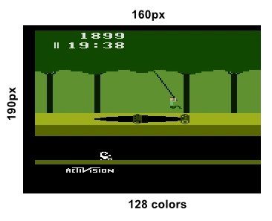
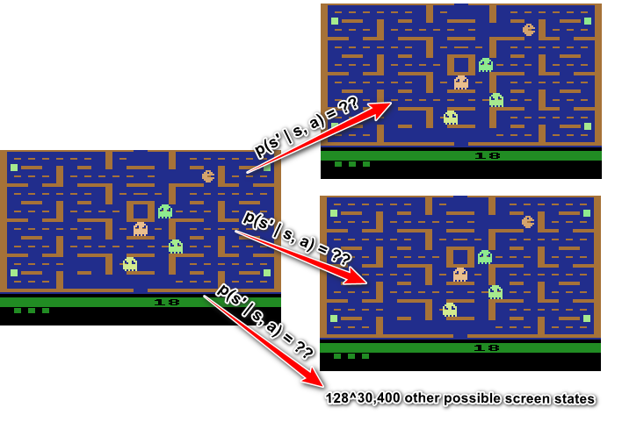
Weaknesses of Value Iteration
Not appropraite for large state spaces
Assume Atari VCS has 160x192 pixels, 128 colors (NTSC)*
128^{(160*192)} = 128^{30,400} screen states
Too big to hold V[s] or Q[s, a]
Too big to iterate over all states
Requires full knowledge of dynamics
VI assumes full knowledge of dynamics
Thus, no need for trial-and-error
Assumption not reasonable for complex problems
*Due to limitations and technical details of Atari VCS graphics implementation, this is an approximation.
Notes:
Atari 2600 (NTSC Version)
128 colors https://en.wikipedia.org/wiki/List_of_video_game_console_palettes#Atari_2600
160x192 resolution: http://atariage.com/forums/topic/169128-what-is-the-atari-2600-screen-resolution/
This isn't precise becuase of how Atari 2600 worked with analog TVs. But we'll go with it

Slide 25
Overcoming Limitations
 | Rely on Known Dynamics | Use Samples to Learn Dynamics to Learn Transitions, Rewards
Tabular Methods Store Full Table of V^{π}[s] or Q*[s, a] | Exact Methods Value Iteration Policy Iteration | Monte Carlo (learn from sampled full episodes) Temporal Difference Methods (sample individual transitions) TD(0), TD(lambda) (learn V^{π}[s] on-policy from samples) Sarsa (learn Q*[s, a] on-policy from (s, a, r, s', a) samples) Q-Learning (learn Q*[s, a] off-policy from (s, a, r, s') samples)
Parametric Value Function Approximations Approximate q*(s, a) with a parametric function approximator (i.e., neural nets) |  | Deep Q-Learning Learn neural network approximation to q*(s, a) off-policy First method to solve Atari 2600 Games (Mnih, V., Kavukcuoglu, K., Silver, D., Graves, A., Antonoglou, I., Wierstra, D., & Riedmiller, M. (2013). Playing Atari with Deep Reinforcement Learning. Retrieved from http://arxiv.org/abs/1312.5602) (cited > 999 times)
Notes:
Monte Carlo
Estimates v_pi(s)
Uses full trajectories to calculate G_t to calculate Bellman error, so must wait till end of episode
On policy because we are evaluating pi
TD methods (TD(0), Sarsa, Q-Learning) capture (s, a, r, s', [a]) tuples through exploration and can update on-line (not wait till end of episode).
TD(0)
Estimates v_pi(s)
Update is exponentially decaying update of V using Bellman error: V[S_t] = V[S_t] + alpha[R_t+1 + gamma*V[S_t+1] - V[S_t]]
Calculates V_pi(s) on-policy using samples and exponentially decaying average
On-Policy because we are evaluating pi
Sarsa
Estimates Q(s,a) approximating q*
Update is exponentially decaying update of Q using Bellman error: Q[S_t, A_t]=Q[S_t, A_t] + alpha[R_t+1 + gamma*Q[S_t+1, A_t+1] - Q[S_t, A_t]]
On-policy: Uses a two-step look ahead (s, a, r, s, a) (the second 'a' is calculated from the current policy, hence on-policy)
Converges as long as all state-action pairs visited infinite number of times and policy shifts from eps-greedy to fully greedy (on-policy) in the limit
Eps-greedy most converge to fully greedy because we want to find the optimal policy, which is greedy w.r.t. q*(s) and this is on-policy. So we must end up on-policy in the end. Else we will get an incorrect (low) estimate for q*(s) because our Bellman error calculation will be wrong (because future steps aren't fully following the policy)
Q-Learning
Estimates Q(s,a) approximating q*
Update is exponentially decaying update of Q using Bellman error calculated on the greedy-optimal (max_a) next action per bootstrap estimate:
[S_t, A_t]=Q[S_t, A_t] + alpha[R_t+1 + gamma*max_a(Q[S_t+1, A_t+1]) - Q[S_t, A_t]]
Off-policy: because the Bellman error is not calculated based on the 2nd action taken by the policy, but by the bootstrapped (Q-table lookup) value of the best possible next action (hence, the max_a)
DQN
Why use ANN?
Table would be too big
Will never visit every state – NN generalizes to unseen states

Slide 26
Q-Learning
Let Q[s, a] = 0 for all s in S
For episode
While episode isn't finished
Choose an epsilon-greedy action (sometimes use best action per Q[s, a], sometimes randomly act).
Execute action a, get R and S', and terminal signal from environment
Update Q[s, a] = Q[s, a] + alpha[R + gamma * max_a Q(s', a) - Q[s, a]]
#Exponentially weighted update to Q[s, a]
# If terminal, target is just R, because no next steps
S = S' # Continue episode
Target
Bellman Error

Slide 27
Deep Q-Learning Intuition
While not Converged
Sample action using eps-greedy policy
Execute action to get (s, a, r, s', terminal) tuple and add to dataset

Slide 28
Resources
Freel Online RL Courses
OpenAI RL Bootcamp (https://sites.google.com/view/deep-rl-bootcamp/lectures)
Lecture 1 – Pieter Abbeel on MDPs and Exact Solution Methods
Lecture 2 – Rocky (Yan) Duan on Temporal Difference (TD) Methods
Lecture 3 – Vlad Mnih on Deep Q-Learning / Atari (see also http://arxiv.org/abs/1312.5602)
David Silver 2015 RL Course (heavier foundations focus (e.g., MDPs, etc.),) (http://www0.cs.ucl.ac.uk/staff/D.Silver/web/Teaching.html)
Sergey Levine Berkeley Fall 2018 CS294-112 (heavier DNN, robotics, and current trends focus) (http://rail.eecs.berkeley.edu/deeprlcourse/)
Books
Sutton, Richard S.., and Andrew G.. Barto. Reinforcement Learning: an Introduction. The MIT Press., 2018. Available as free PDF at http://incompleteideas.net/book/the-book-2nd.html
Géron, Aurélien. Hands-on Machine Learning with Scikit-Learn and TensorFlow: Concepts, Tools, and Techniques to Build Intelligent Systems. O'Reilly, 2018. (See RL chapter; Note: don't purchase old edition; wait for 2019 second ed. covering Tensorflow 2.0)

